Slide 1

Sanjivani College of Engineering, Kopargaon-423603
Sanjivani Rural Education Society’s
(An Autonomous Institute Affiliated to Savitribai Phule Pune University, Pune)
NAAC ‘A’ Grade Accredited
Department of Information Technology
(UG program, NBA Accredited)
Software Engineering Modeling & Design
“Online Agriculture Management ”
SEMD incharge Dr. S. N. Gunjal
Class : SY IT B

Slide 2

Group Members :
Roll No. | PRN | Name
151 | 0125UITF2002 | Sabale Gayatri
152 | 0125UITF2008 | Pol Urmila
153 | 0125UITF2009 | Daga Nupur
154 | 0125UITF2010 | Ghule Divya
164 | 0125UITM2017 | Shelke Chaitanya

Slide 3
Introduction :
Agriculture is the backbone of the economy and plays a crucial role in providing food and employment. However, many agricultural activities are still carried out using traditional methods, which limits efficiency and productivity. Farmers often face challenges such as lack of proper record management, limited access to real-time information, and dependency on intermediaries.
With the advancement of technology, there is a need to modernize agricultural practices by adopting digital solutions. An Online Agriculture Management System is designed to provide a centralized platform where farmers can manage their activities efficiently. It helps in maintaining crop records, accessing weather updates, getting recommendations, and connecting directly with markets.
This system aims to reduce manual effort, improve transparency, and support better decision-making, ultimately leading to increased productivity and better outcomes for farmers.

Slide 4

Functional Requirements :
FR1: The system shall allow farmers to register by providing personal and farm details.
FR2: The system shall allow registered users to log in using valid credentials.
FR3: The system shall allow farmers to add, update, and delete crop details.
FR4: The system shall provide real-time weather updates to users.
FR5: The system shall provide recommendations for fertilizers and pesticides.
FR6: The system shall allow farmers to view and access market prices of crops.
FR7: The system shall provide an online marketplace for buying and selling agricultural products.
FR8: The system shall display information about government schemes related to agriculture.
FR9: The system shall allow administrators to manage user accounts.
FR10: The system shall allow administrators to update system data such as schemes, prices, and recommendations.

Slide 5
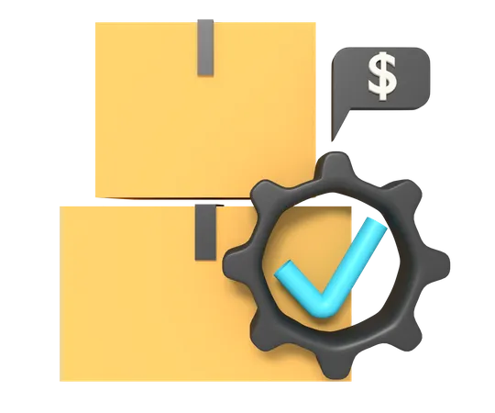
Non Functional Requirements :
NFR1 (Performance): The system shall respond to user requests within a reasonable time.
NFR2 (Security): The system shall ensure secure login and protect user data from unauthorized access.
NFR3 (Usability): The system shall provide a user-friendly interface for easy navigation.
NFR4 (Reliability): The system shall operate without failure under normal conditions.
NFR5 (Scalability): The system shall support an increasing number of users without performance degradation.
NFR6 (Availability): The system shall be available to users at all times except during maintenance.
NFR7 (Maintainability): The system shall be easy to maintain and update.
NFR8 (Compatibility): The system shall be accessible on different devices such as mobile, tablet, and desktop.

Slide 6
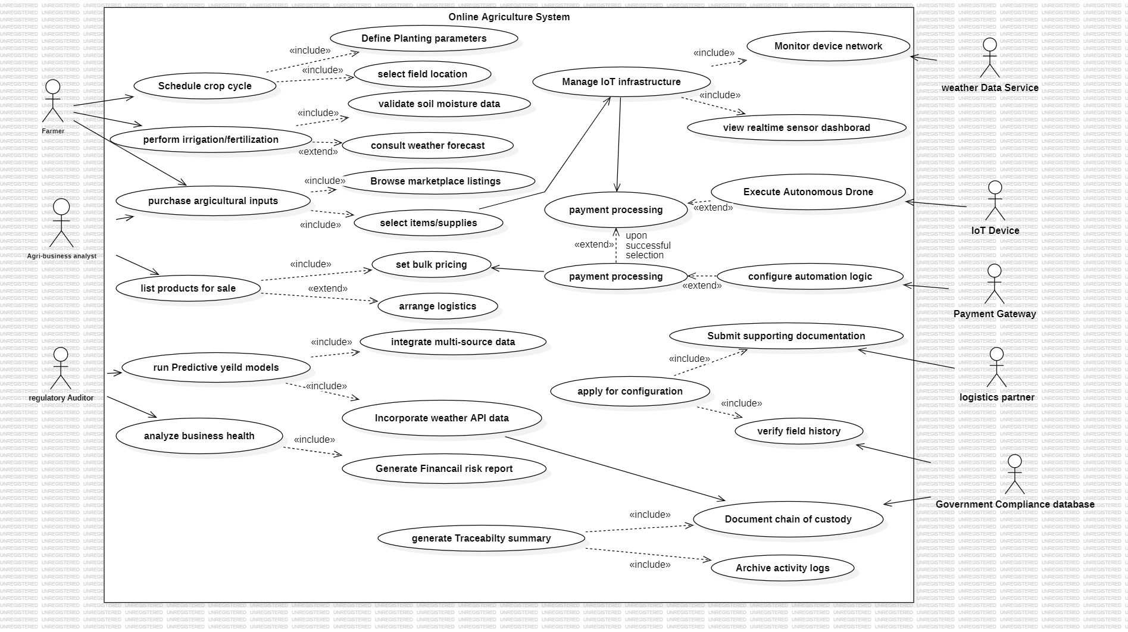
Use Case Diagram :

Slide 7
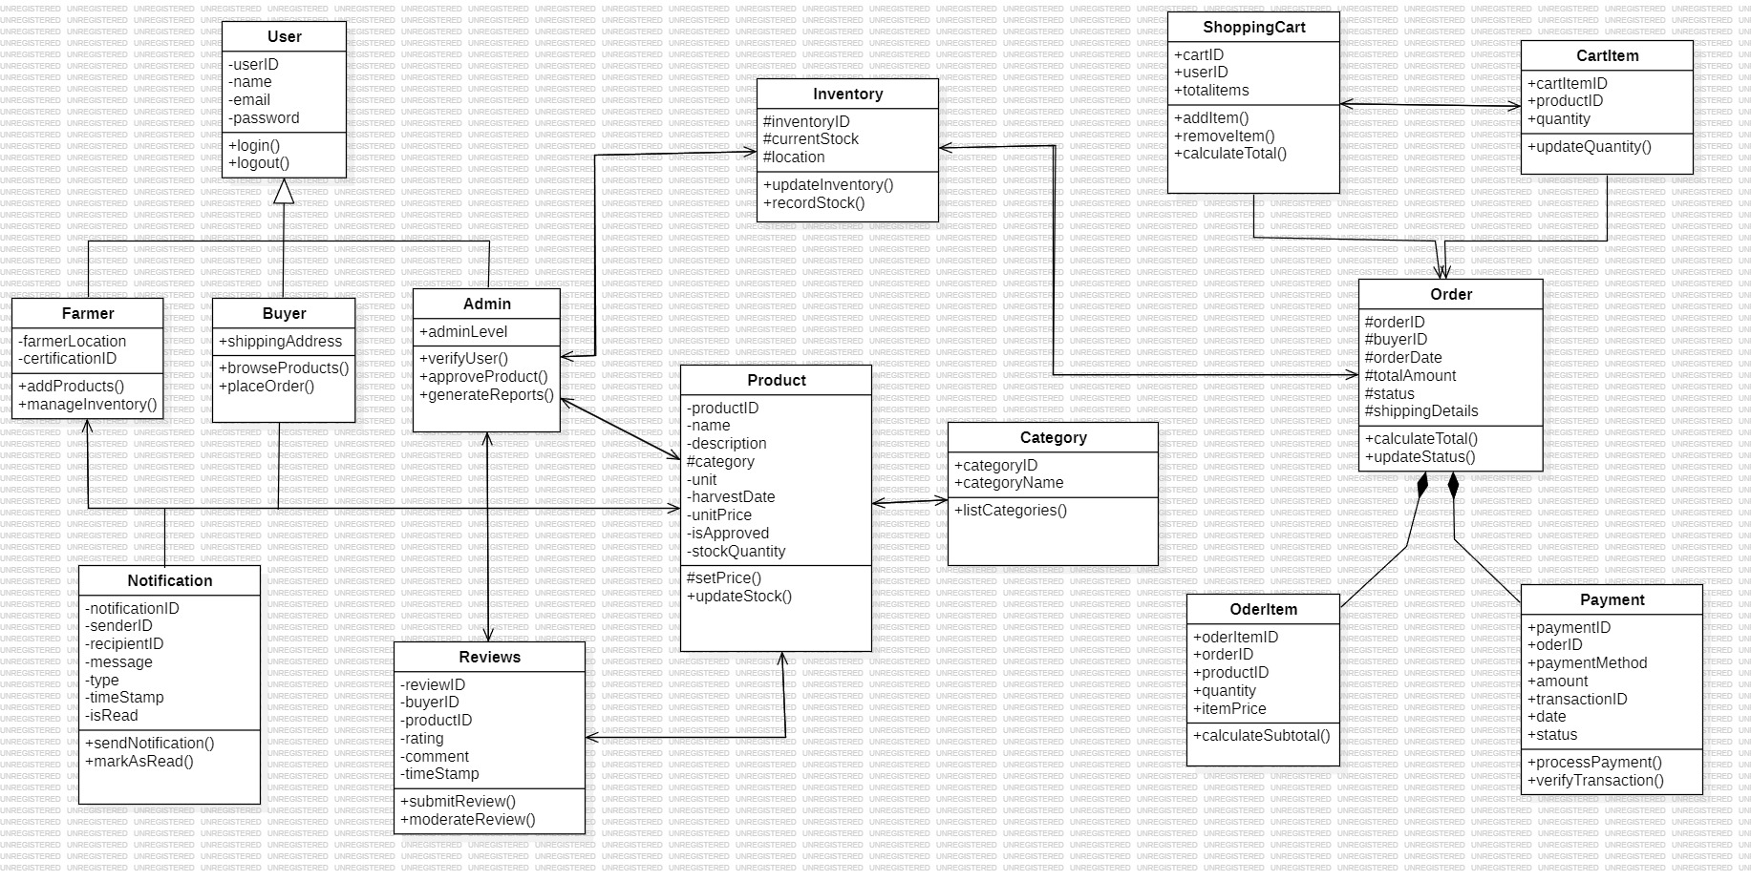
Analysis Class Diagram :

Slide 8
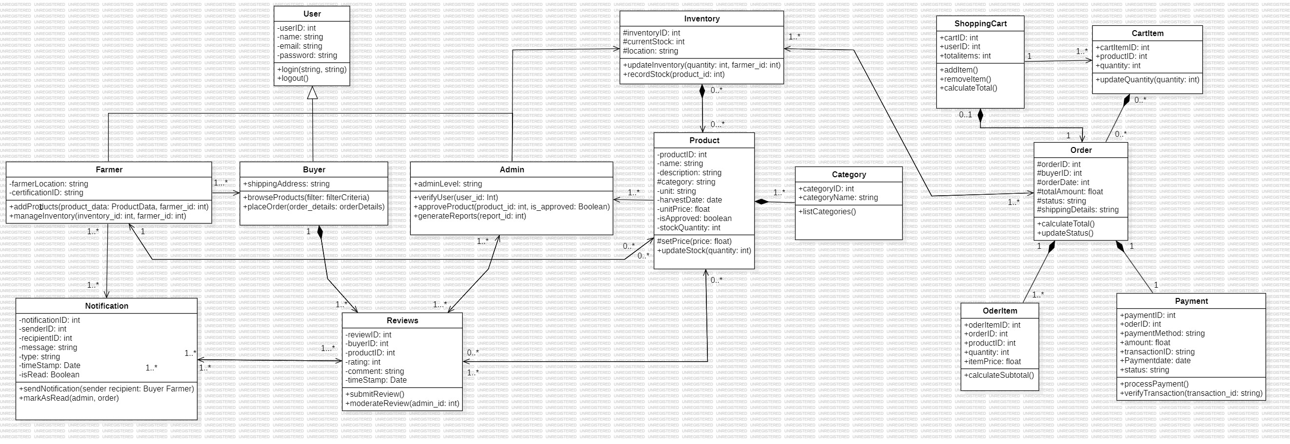
Design Class Diagram :

Slide 9
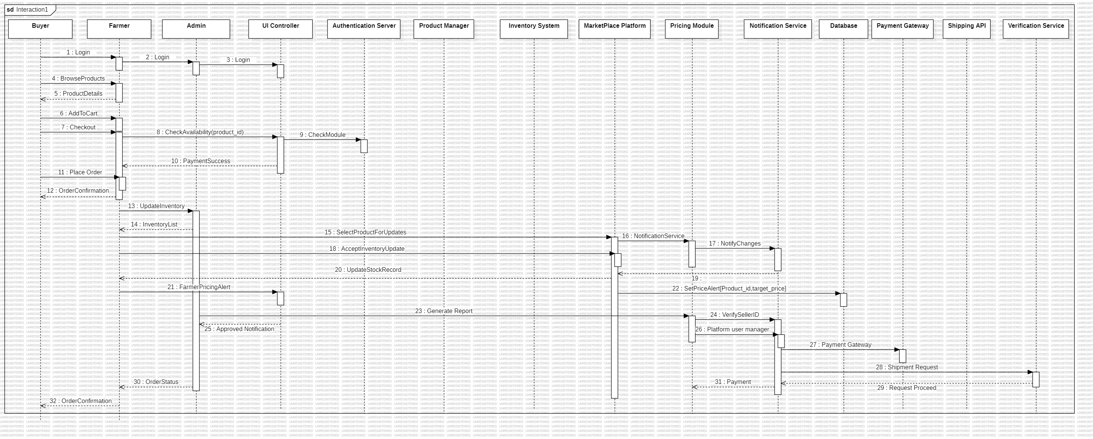
Sequence Diagram –

Slide 10
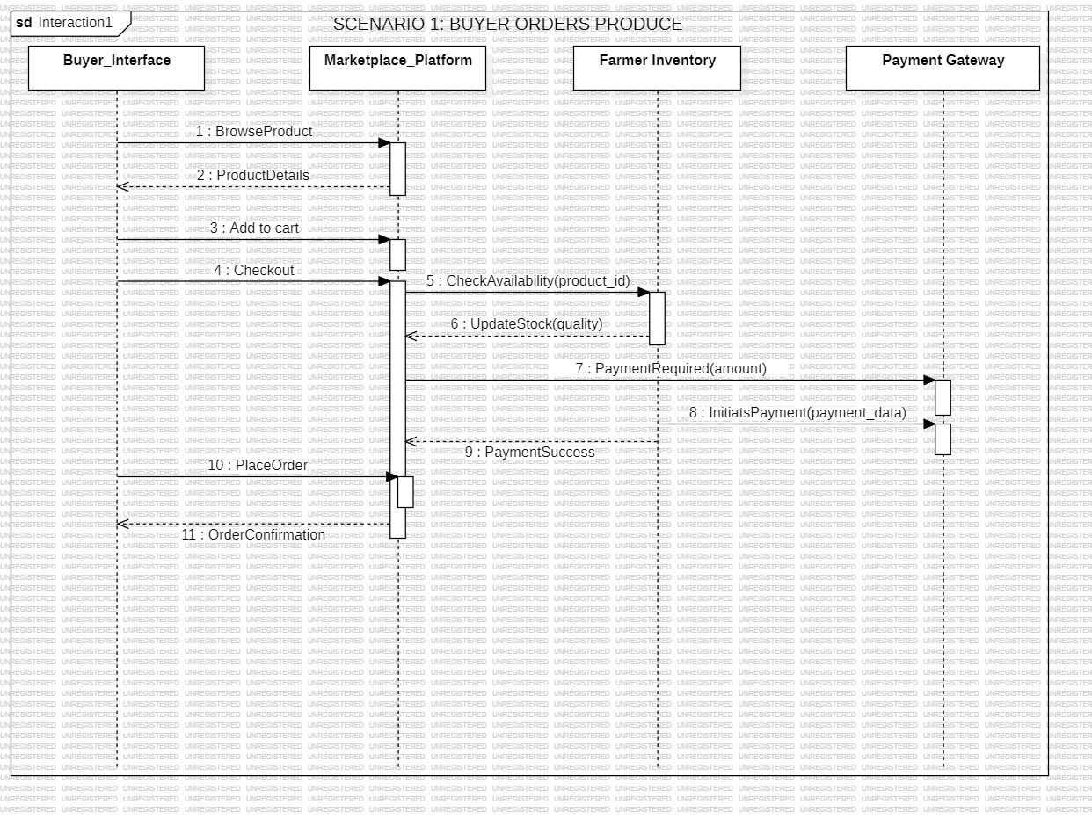
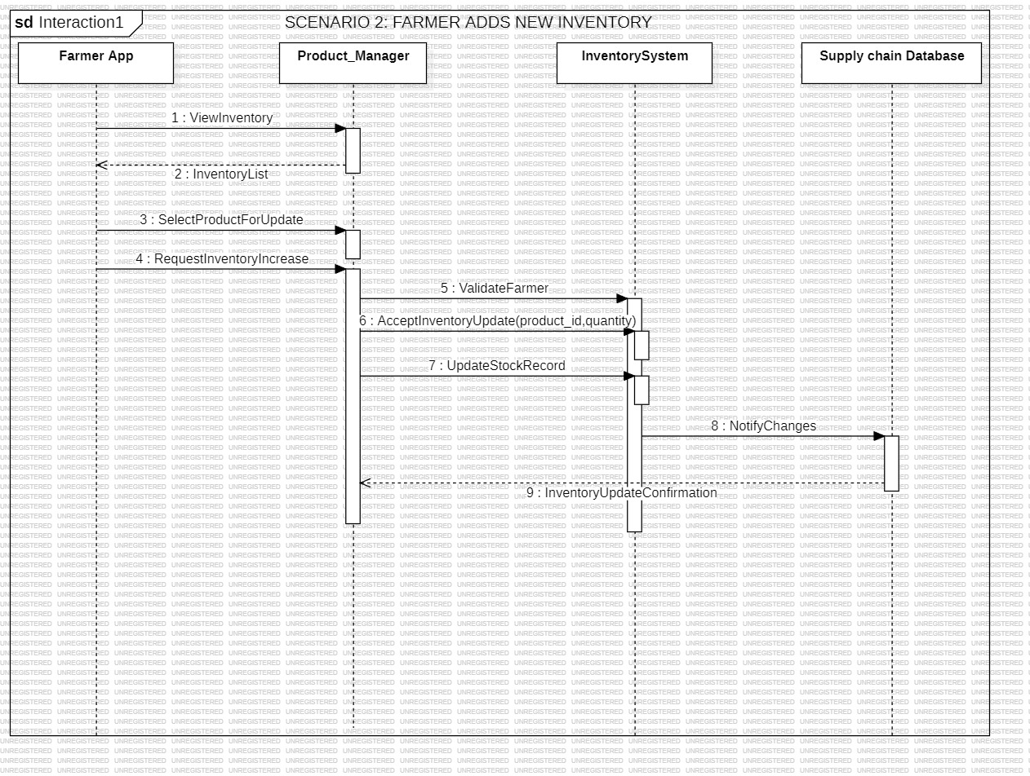
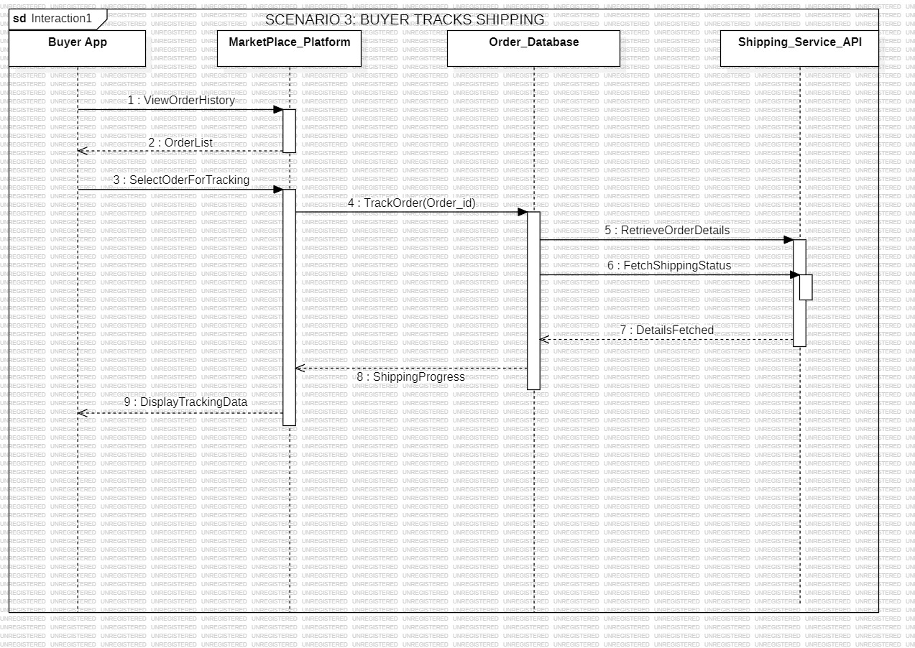
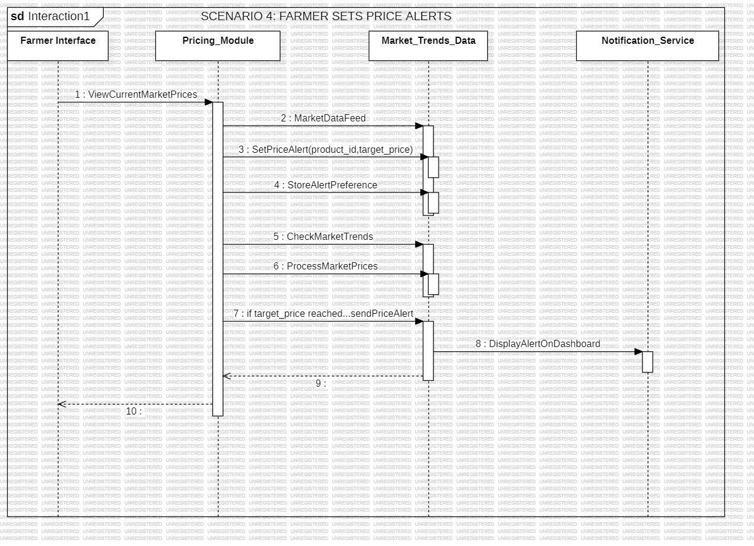
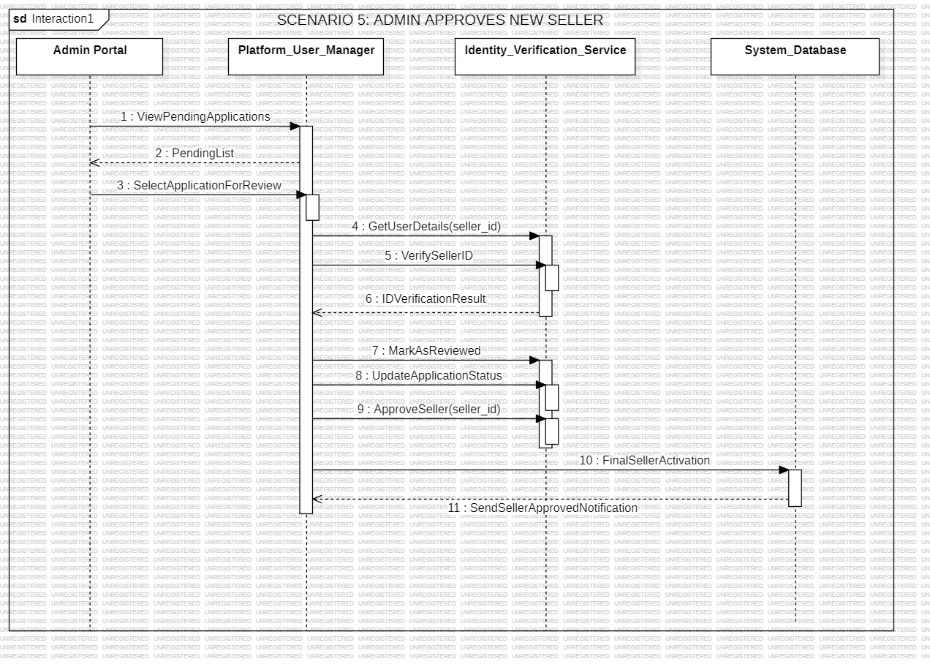
Sequence Diagram –

Slide 11
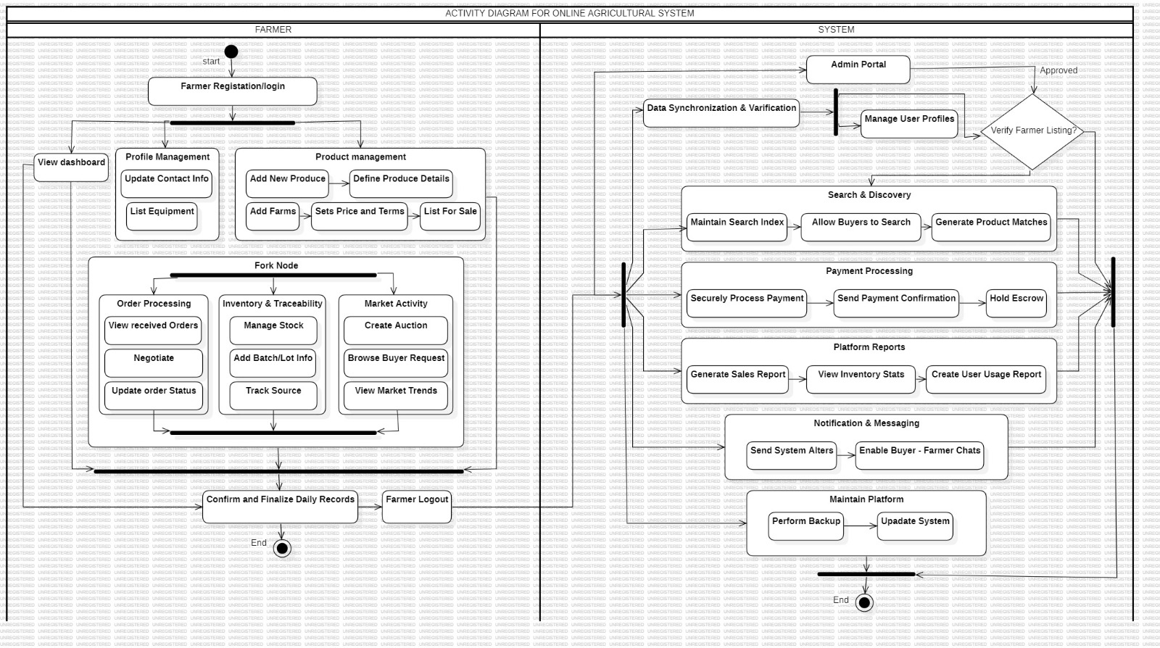
Activity Diagram :

Slide 12
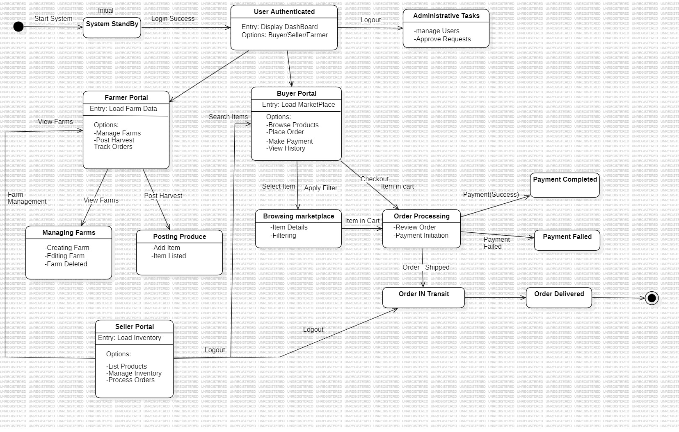
State Machine Diagram :

Slide 13
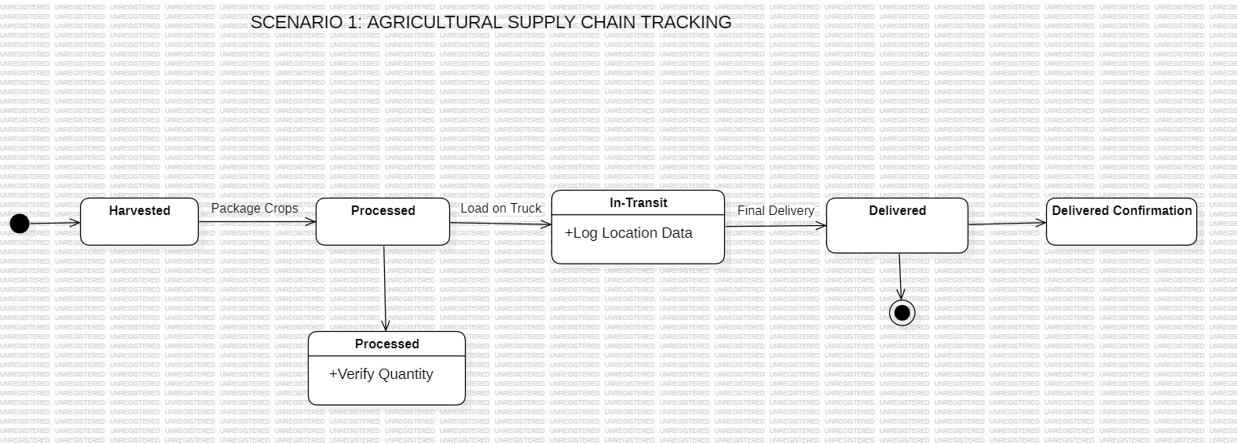
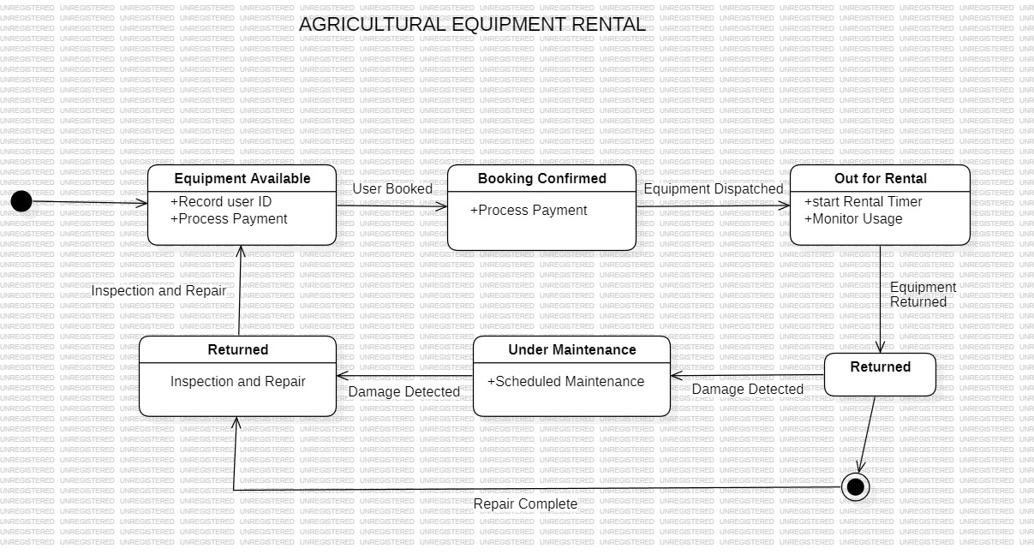
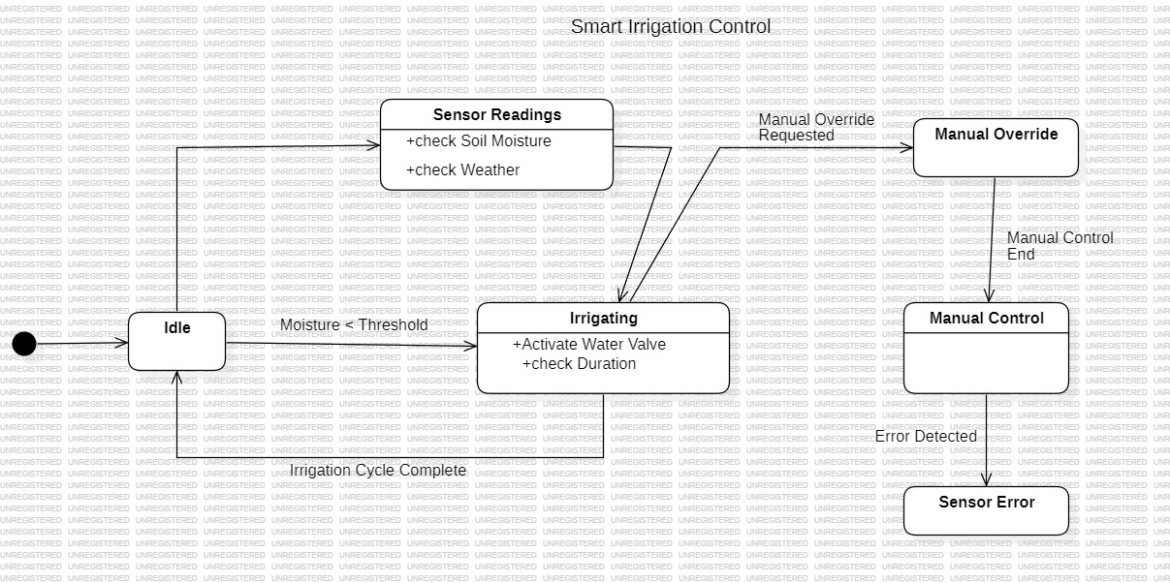
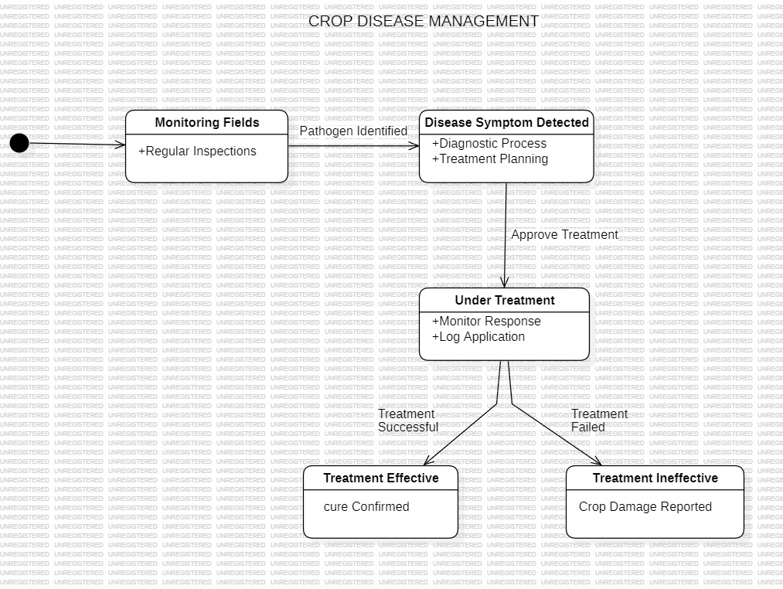
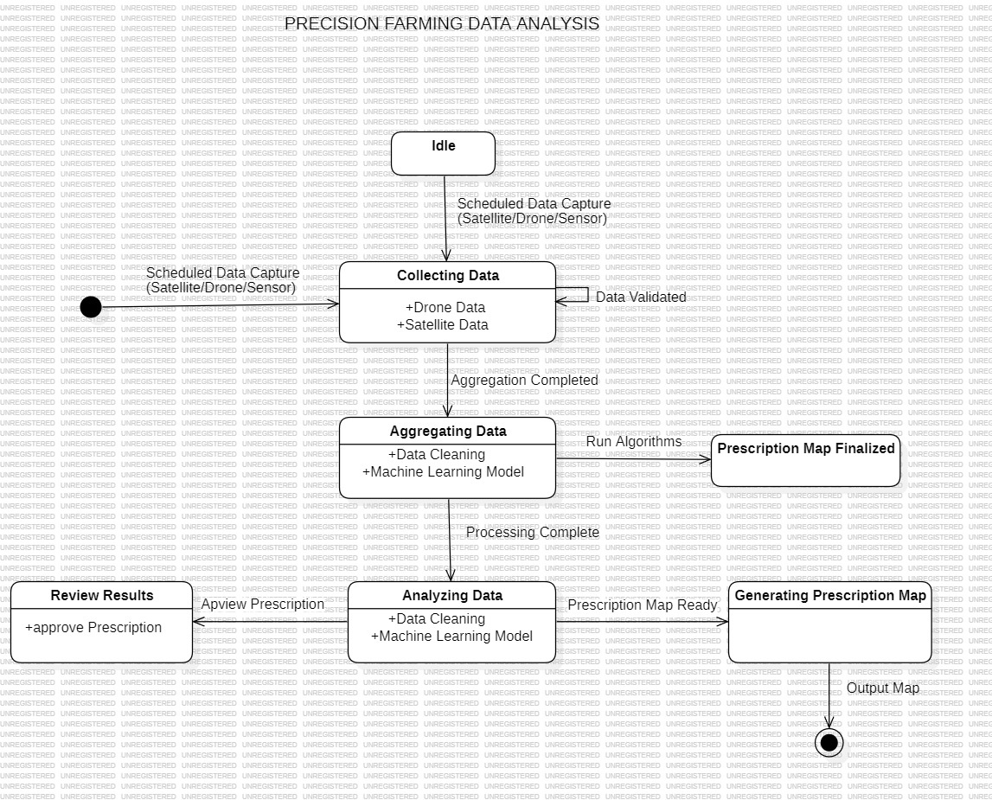
State Machine Diagram :

Slide 14
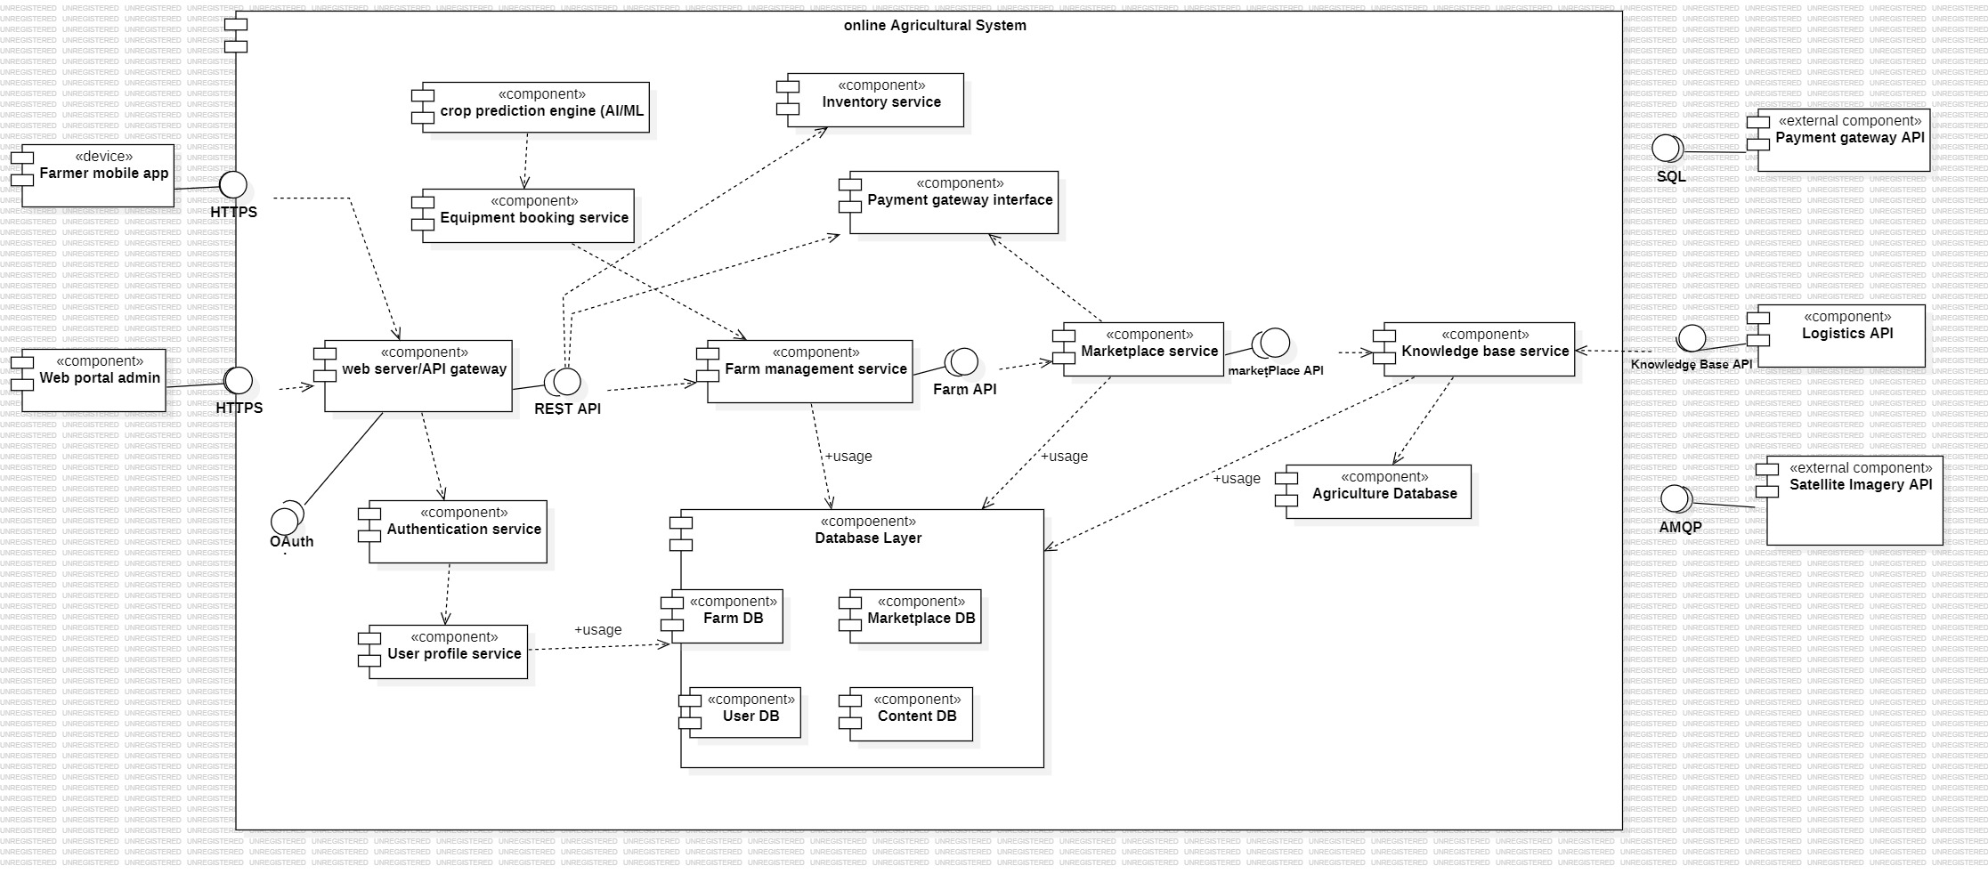
Component Diagram :

Slide 15
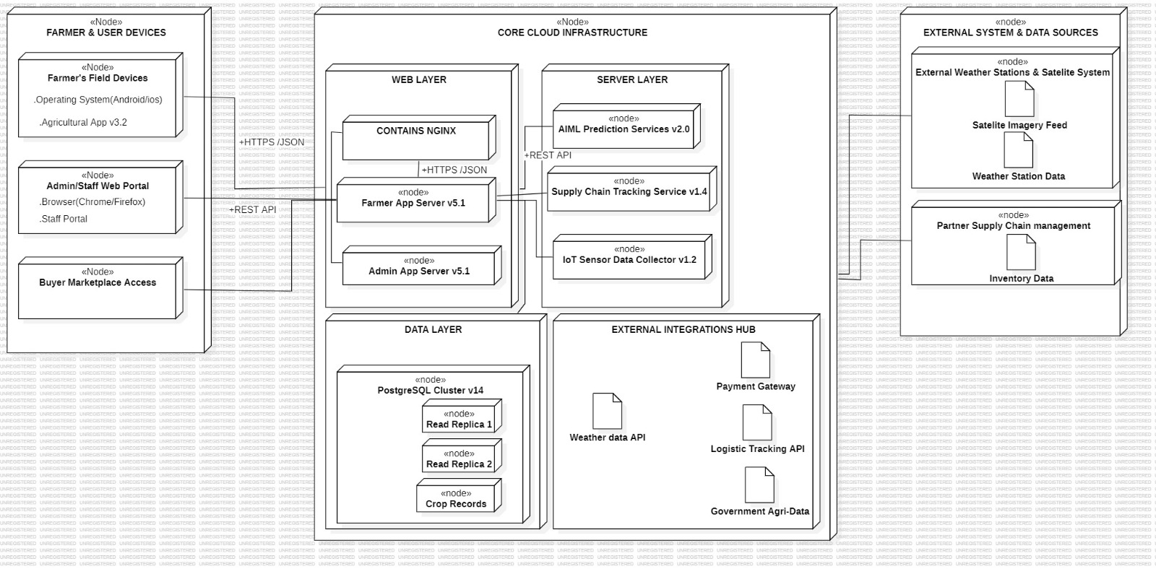
Deployment Diagram :

Slide 16
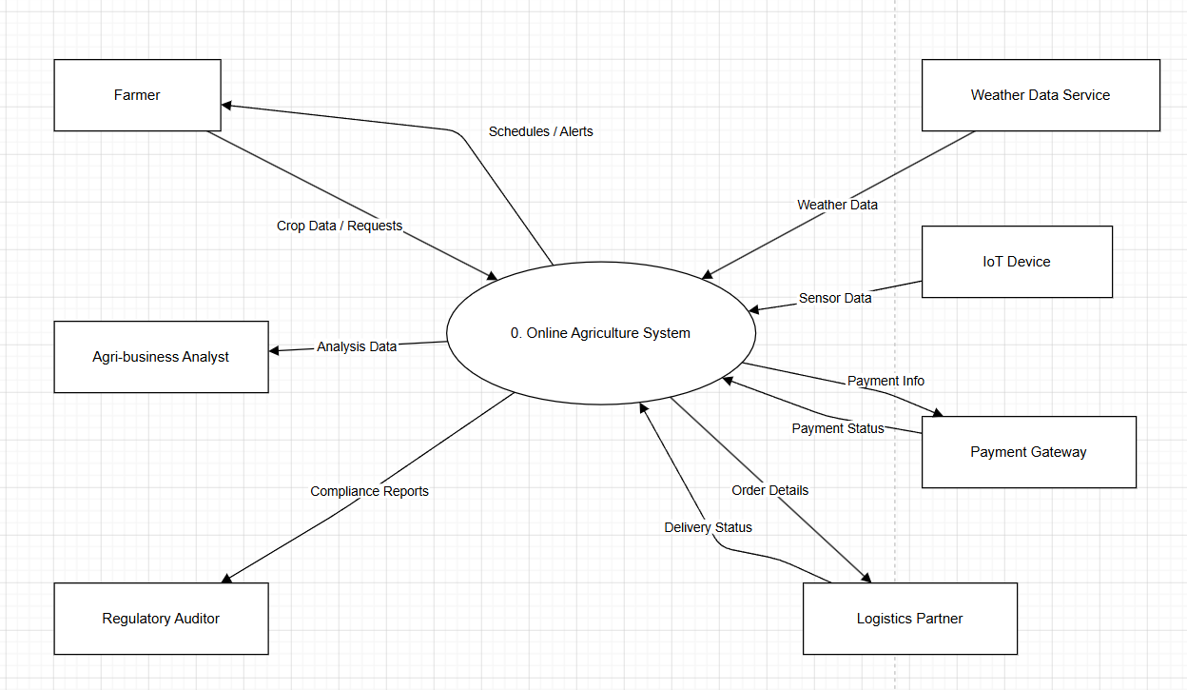
Data Flow Diagram (DFD):
DFD Level 0

Slide 17
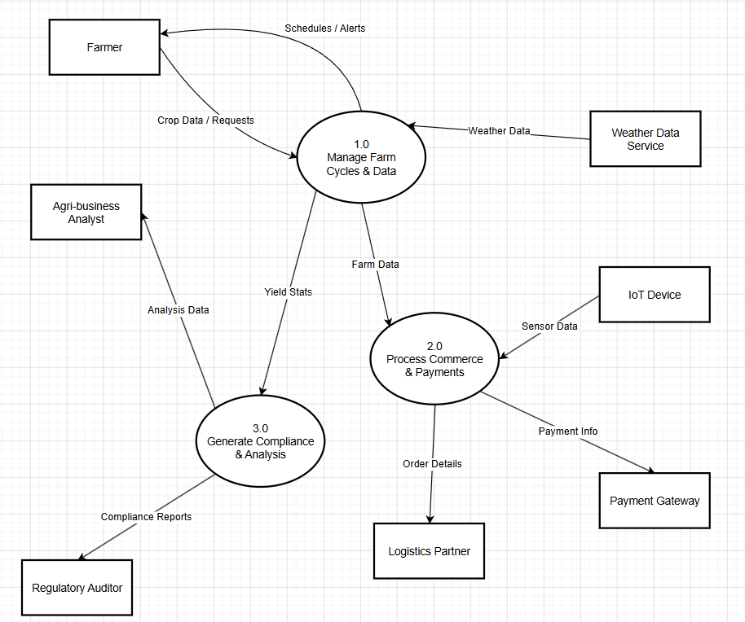
Data Flow Diagram (DFD):
DFD Level 1

Slide 18
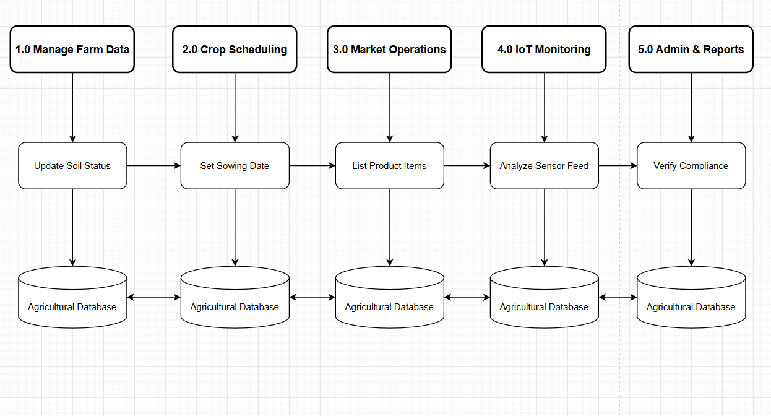
Data Flow Diagram (DFD):
DFD Level 2

Slide 19
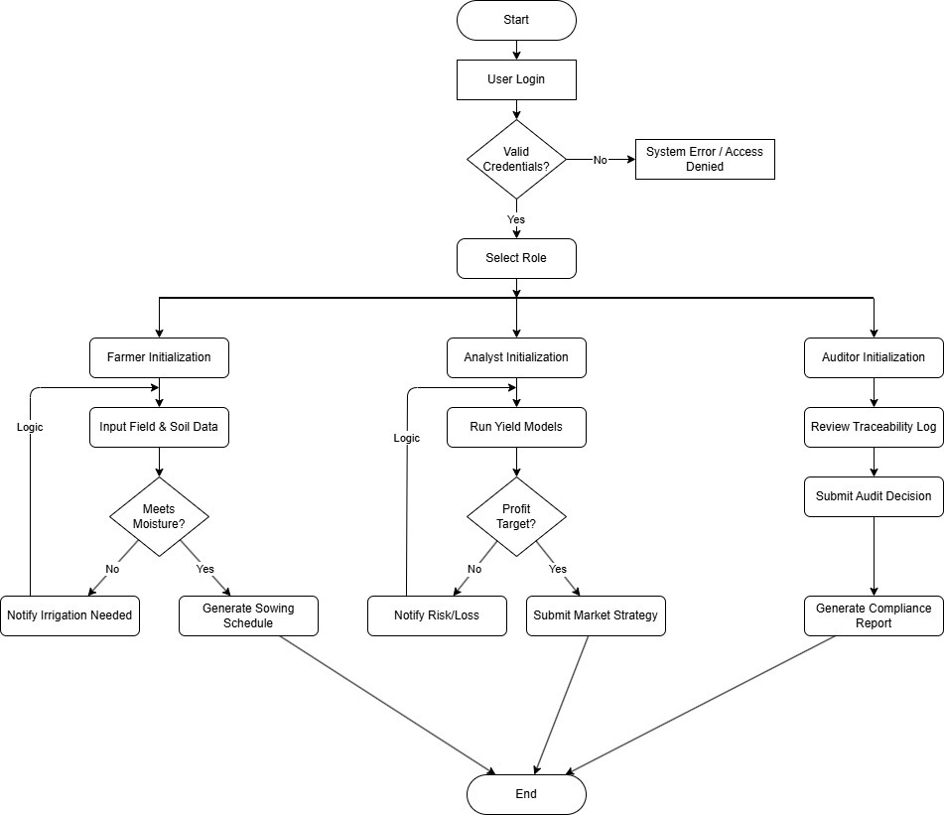
Control Flow Diagram (CFD):

Slide 20
Conclusion:
The Online Agriculture Management System provides an effective solution to the problems faced in traditional farming methods. By digitizing agricultural activities, the system helps farmers manage their data efficiently, access real-time information, and reduce dependency on intermediaries.
The system improves transparency, reduces manual effort, and supports better decision-making. Features such as crop management, weather updates, marketplace access, and government scheme information make the system highly useful for farmers.
Overall, this project contributes to modernizing agriculture by integrating technology, leading to improved productivity, better resource management, and increased farmer satisfaction.
.

Slide 21
References:
1. Sommerville, I. Software Engineering, 10th Edition, Pearson Education.
2. Pressman, R. S. Software Engineering: A Practitioner’s Approach, McGraw-Hill.
3. Elmasri, R. and Navathe, S. B. Fundamentals of Database Systems, Pearson.
4. Object Management Group (OMG), Unified Modeling Language (UML) Specification.
5. IEEE, Software Requirements Specification (SRS) Standards.
6. Research papers and articles on Online Agriculture Management.

